Slide 1
Data Analysis in Criminal Justice
Hypothesis Testing with Three or More Population Means
(Analysis of Variance)

Slide 2
Hypothesis Testing with Three or More Sample Means (ANOVA)
Logic of ANOVA
Computation of ANOVA
Measure of association

Slide 3
Inference with 3+ Sample Means
Generalization of the two-sample case
Research Question
Do the differences that we observe among the sample means indicate that there are significant differences across groups in the population?
Examples
Sentence length as a function of offense type (violent, property, drug, other)
Fear of crime as a function of residential location (urban, suburban, rural)
Offending as a function of race/ethnicity (white, black, Hispanic, Asian, other)

Slide 4
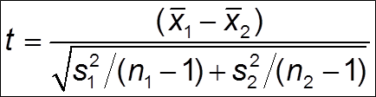

Inference with 3+ Sample Means (cont.)
Pairwise t-tests
Disadvantages
Cumbersome
3 groups: 3 tests; 4 groups: 6 tests; 5 groups: 10 tests
Probability of committing a type I error on any given test is greater than $α$ (= .05)
3 groups: p=.143; 4 groups: p=.185; 5 groups: p=.226

Slide 5

Logic of ANOVA
We want a statistical test that will help us decide whether the observed differences are the result of sampling variation or real differences
Analysis of variance = ANOVA
Three or more sample means
Global test = joint significance of several means
Constant prob. of type I error ($α$)

Slide 6
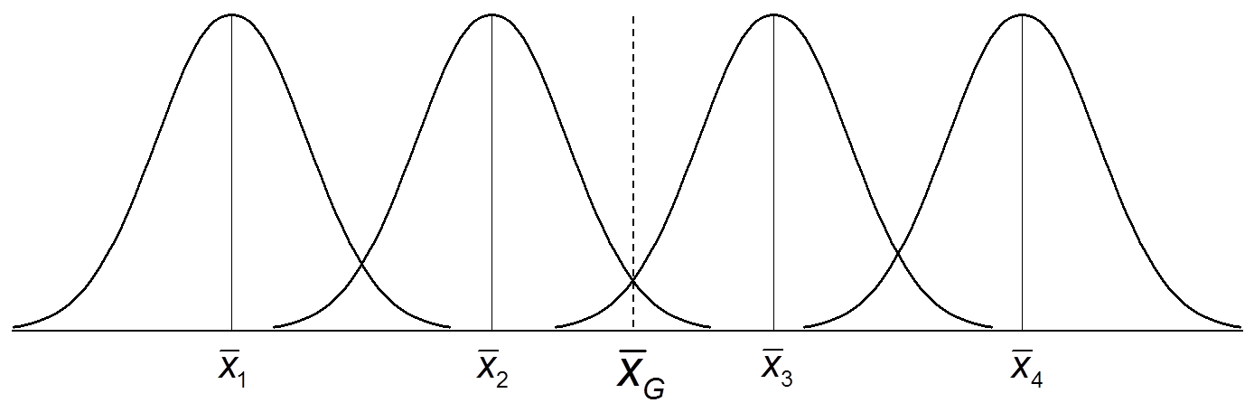
Why Variance?
Analysis of variance
Ratio of the variability between groups to the variability within groups (F-ratio)

Slide 7
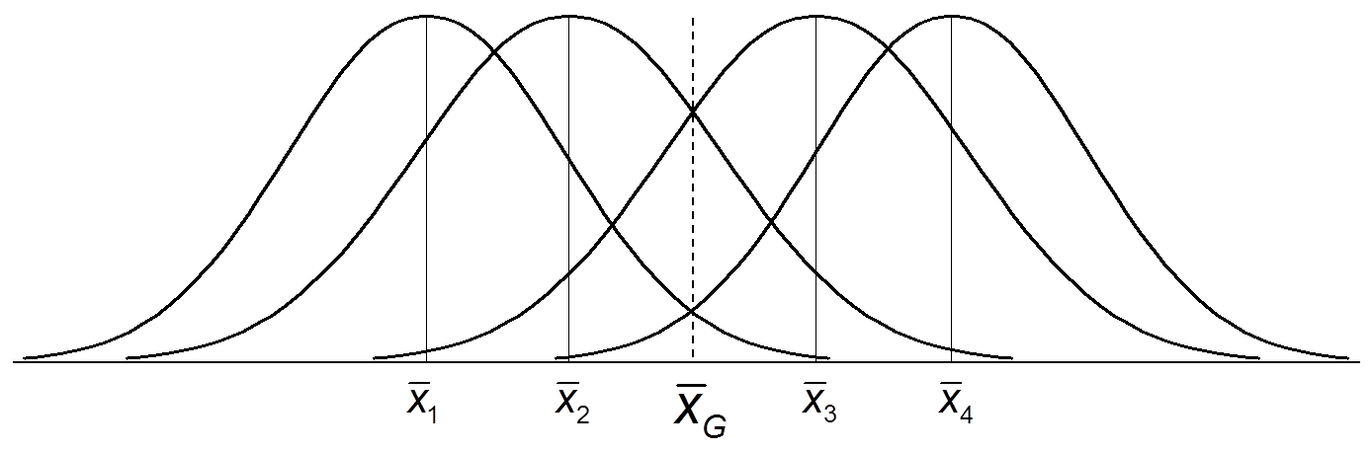
Why Variance? (cont.)
More variability within groups than between
F < 1.0
Too much overlap, there is no relationship between group membership and outcome

Slide 8
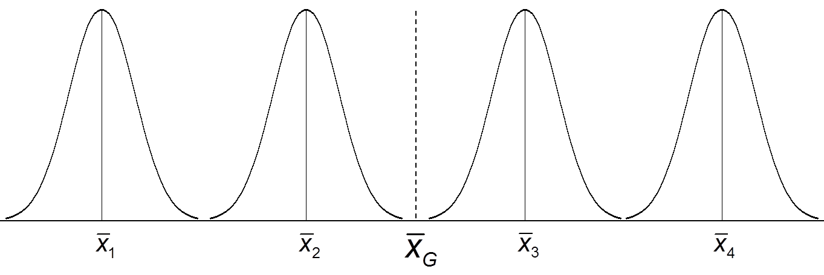
Why Variance? (cont.)
More variability between groups than within
F > 1.0
Little or no overlap, there is a relationship between group membership and outcome

Slide 9
New Probability Distribution
F-distribution
Ratio of variability between groups to variability within groups
Large F-ratio (i.e., significantly grater than 1.0) will lead us to reject the null hypothesis of no association between group membership and the outcome of interest

Slide 10



Sum of Squares
Sum of squares = numerator of variance
Total sum of squares (${df}_{T}$ = N – 1)
Between-group sum of squares (${df}_{B}$ = k -1)
Within-group sum of squares (${df}_{W}$ = N – k)

Slide 11

Sum of Squares (cont.)
Total sum of squares
${SS}_{T}= {SS}_{B}+ {SS}_{W}$
Mean square (i.e., variance)
${MS}_{B}= \frac{{SS}_{B}}{{df}_{B}}$
${MS}_{W}= \frac{{SS}_{W}}{{df}_{W}}$
F-ratio
F = $\frac{{MS}_{B}}{{MS}_{W}}$

Slide 12
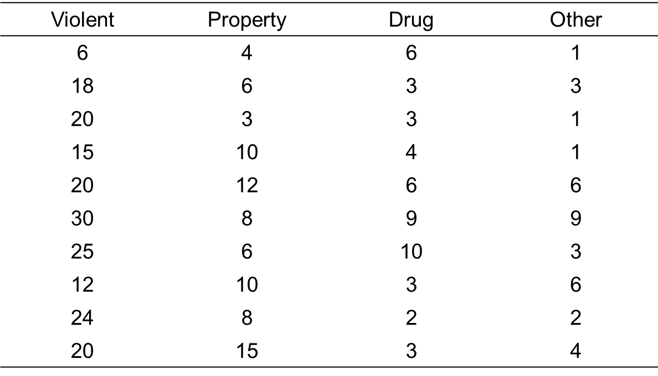
Offense Type & Sentence Length

Slide 13
Offense Type & Sentence Length (cont.)
Step 1: Formally state hypotheses
Step 2: Obtain a probability distribution
Step 3: Make decision rules

Slide 14
Offense Type & Sentence Length (cont.)
Step 4: Calculate the test statistic

Slide 15
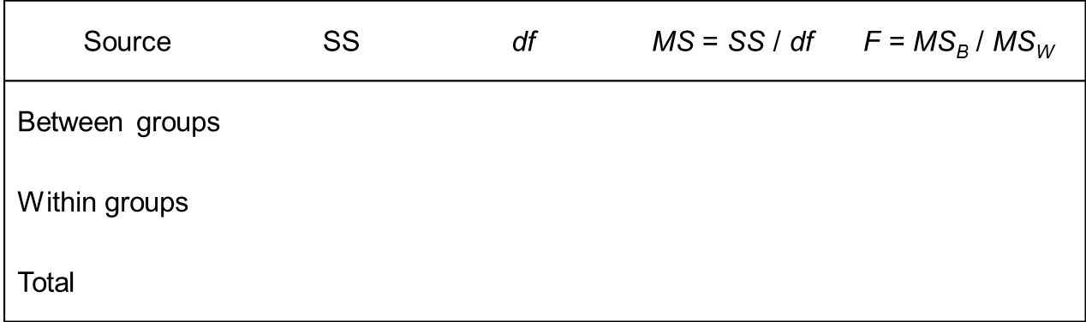

Offense Type & Sentence Length (cont.)
Step 5: Make a decision about $H_{O}$

Slide 16
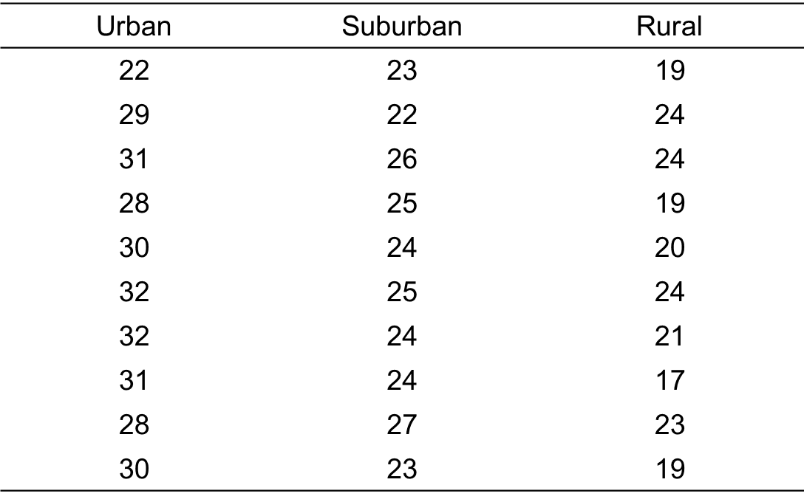
Residential Location & Fear of Crime

Slide 17
Residential Location & Fear of Crime
Step 1: Formally state hypotheses
Step 2: Obtain a probability distribution
Step 3: Make decision rules

Slide 18
Residential Location & Fear of Crime (cont.)
Step 4: Calculate the test statistic

Slide 19

Residential Location & Fear of Crime (cont.)
Step 5: Make a decision about $H_{O}$

Slide 20

Measures of Association
ANOVA tells us whether there is a significant relationship between two variables, but it cannot tell us about the strength of the relationship
Two measures of association
Eta square (${\text{η}}^{2}$)
Epsilon square ($ε^{2})$

Slide 21
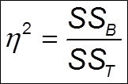
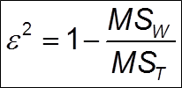
Measures of Association (cont.)
Eta square
Epsilon square
“Explained variance” interpretation
Proportion of the total variance in the dependent variable “explained” by the independent variable

Slide 22
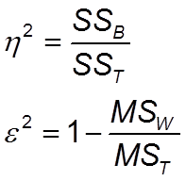
Measure of Association (cont.)
Offense type and sentence length
Interpretation

Slide 23
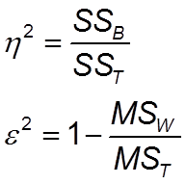
Measure of Association (cont.)
Residential location and fear of crime
Interpretation

